Slide 1
Study at
Vilnius University

Slide 2
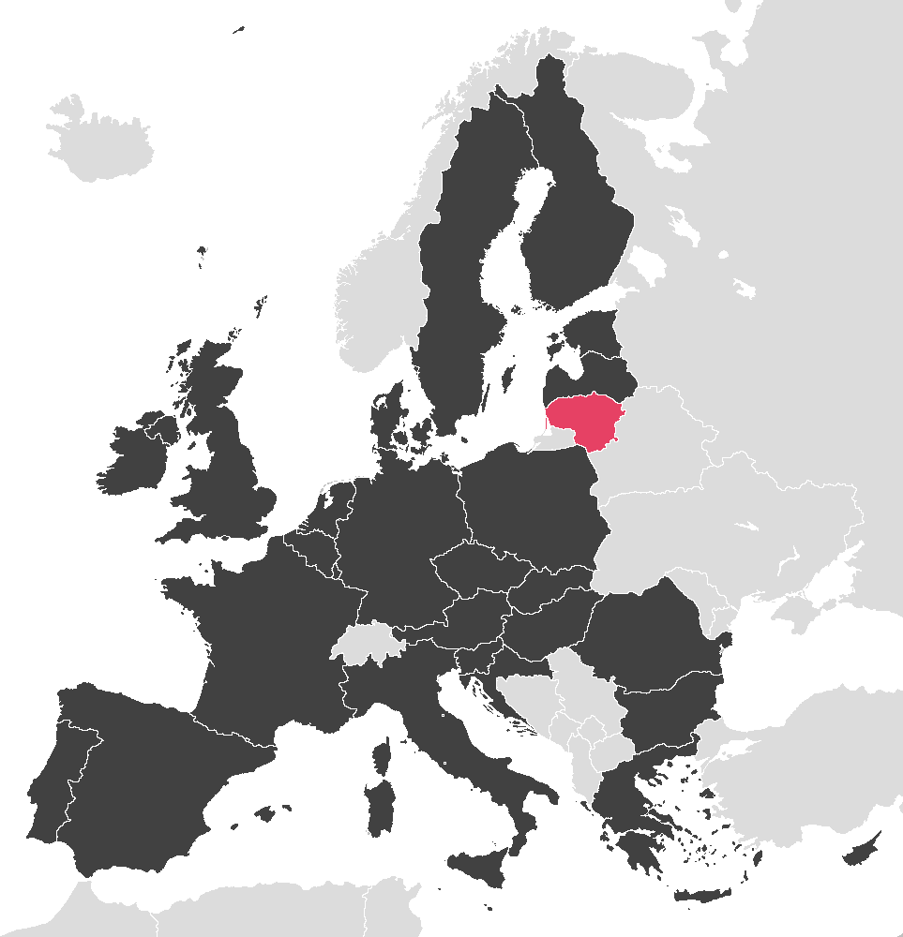
Lithuania
Population: 2,8 million
Size: 65 000 km²
Capital: Vilnius
Language: Lithuanian
Currency: Euro
Member of the EU, NATO, OECD, UN, WTO

Slide 3
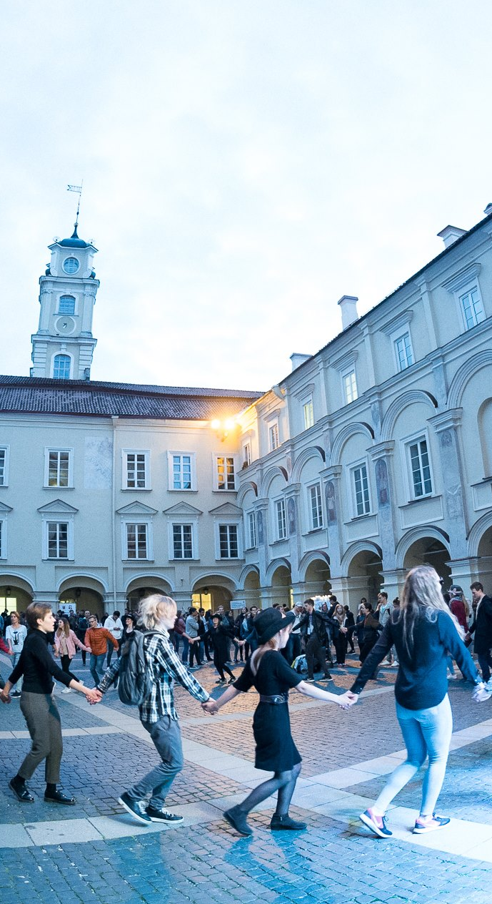
Education in Lithuania
93%
of Lithuanians have secondary or higher education
65%
of all school graduates continue the education in universities and colleges
92%
of Lithuanians speak at least one foreign language
18%
of international students in Lithuanian universities are from India

Slide 4

Vilnius
Capital of Lithuania
Population: >650 000
Location: South-East of Lithuania
Happiest city in Europe*
2nd Youngest capital in Europe
Fastest public WiFi in the world
*93% of citizens are happy to live in Vilnius. Source: EUROSTAT 2016

Slide 5
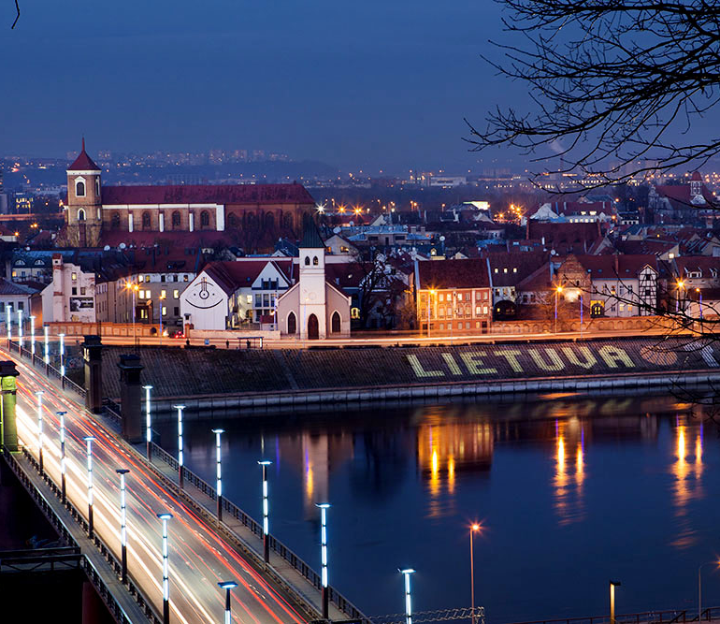
Kaunas
2nd largest city in Lithuania
Former capital (interwar)
Population: >300 000
Student city (11 universities,
50 000 students)
European Capital of Culture (2022)
Located at the confluence of two rivers (Nemunas and Neris)

Slide 6
Vilnius University
Founded in 1579 m.
#1 in Lithuania*
400 in the world*
281 study programmes offered
~1 500
scientific publications annually
24 716 students
*QS World University Rankings, 2021

Slide 7

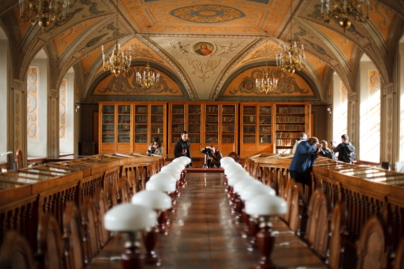
Library
the oldest and one of the largest academic libraries of Lithuania.
founded in 1570 by the Jesuits and as such is nine years older than Vilnius University.
holds 5.4 million documents on shelves measuring 166 kilometres in length.

Slide 8
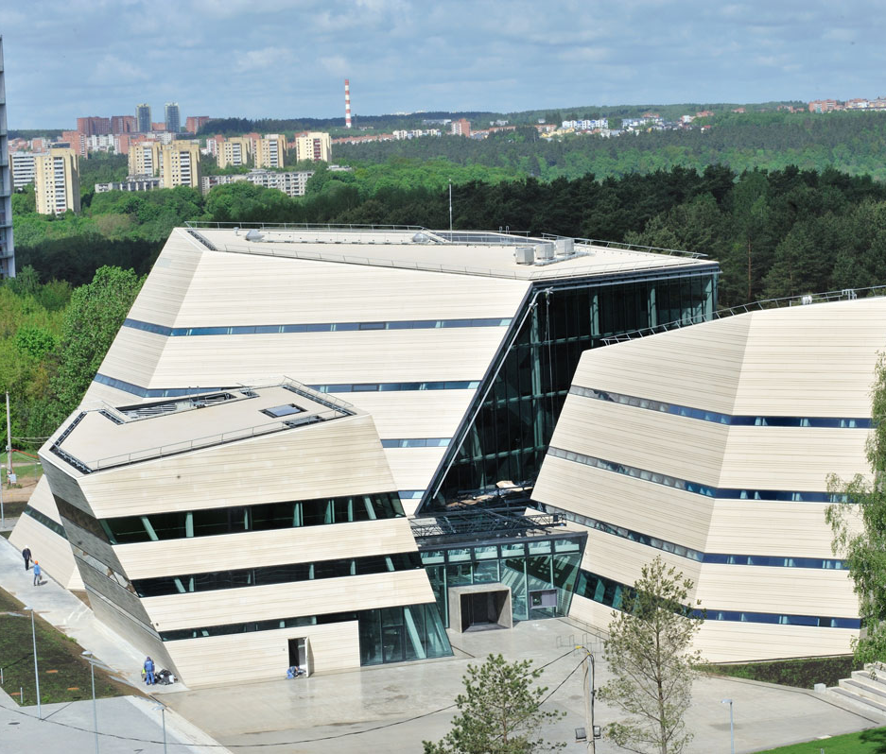
SCIC
Open 24/7
Constructed in 2013
SCIC provides open library stacks, rooms for individual and group work, open reading rooms, lounge islands for a cosy conversation by a cup of coffee, and a playroom for chlidren.

Slide 9

International relations
ERASMUS
NORDPLUS
UTRECHT, MAUI, AEN
BSRUN
CREPUQ
UNICA
ISEP
Scholars at Risk
EUA
IAU
EAIE
ALTE
BUP
Magna Charta Observatory
COIMBRA Group
176
International bilateral agreements
1058
Erasmus+ agreements

Slide 10

Social partners:
Barclays Technologies
Sensor Electronics Technology Inc.
Huawei Technologies Co.
IBM
TELE2
CERN

Slide 11

International projects
Educational Erasmus projects:
Knowledge alliances
Capacity building
Strategic partnerships
Scientific projects:
ES Horizon 2020
NATO Science programmes
Frameworks 5, 6, 7
Others (CERN, EUROSTAT, etc.)

Slide 12
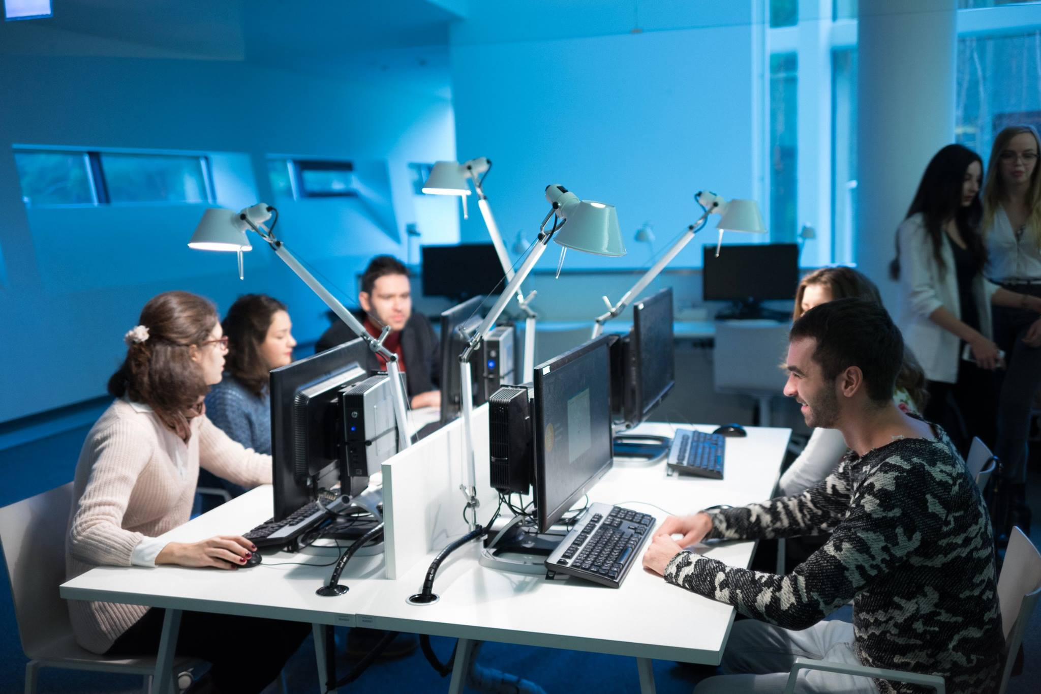

Slide 13
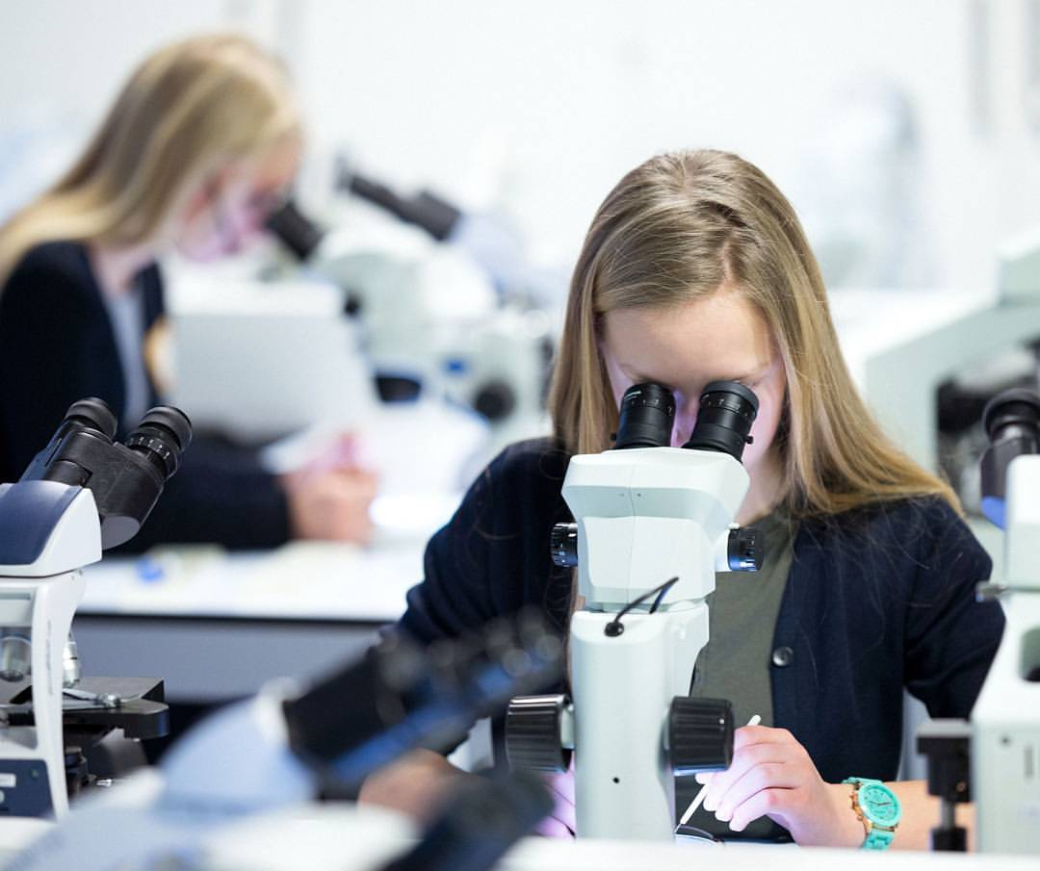
International study programmes
19
Bachelor and integrated study programmes
45
Master study
programmes
29
Fields of doctoral studies
>800
Courses in foreign languages

Slide 14
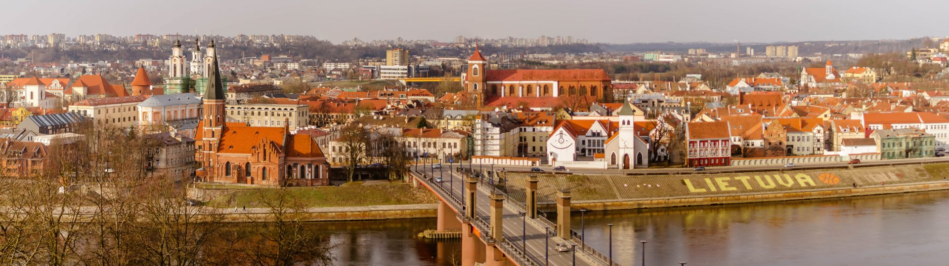
Kaunas Campus
  Study in English:
Bachelor degree study programmes:
Information Systems and Cyber Security
Master degree study programmes:
International Business Management

Slide 15
Courses for exchange students at Kaunas Faculty
https://is.vu.lt/pls/pub/vustud.public_ni$wwwtprs.dalsar_show?p_lpd_srautas_id=32&p_pad_id=24&p_search_str=&p_search_cols=1&p_search_cols=2&p_search_cols=3&p_search_cols=0&p_search_cols=5&p_search_cols=6&p_search_cols=0&p_search_cols=8&p_search_cols=9&p_search_cols=10

Slide 16
Study facilities
The Old Library:
one of the richest collections of old books, historical documents and manuscripts
Scholarly Communication and Information Centre (SCIC):
modern library, open 24/7, providing working places equipped with computers, lounge chairs for discussions/ relaxation, silent reading room, reading room for students with children, room for individual work for professors and PhD students.
Computer facilities:
computers with printers and scanners available at Vilnius University libraries. Free unlimited WiFi across all University campuses.

Slide 17
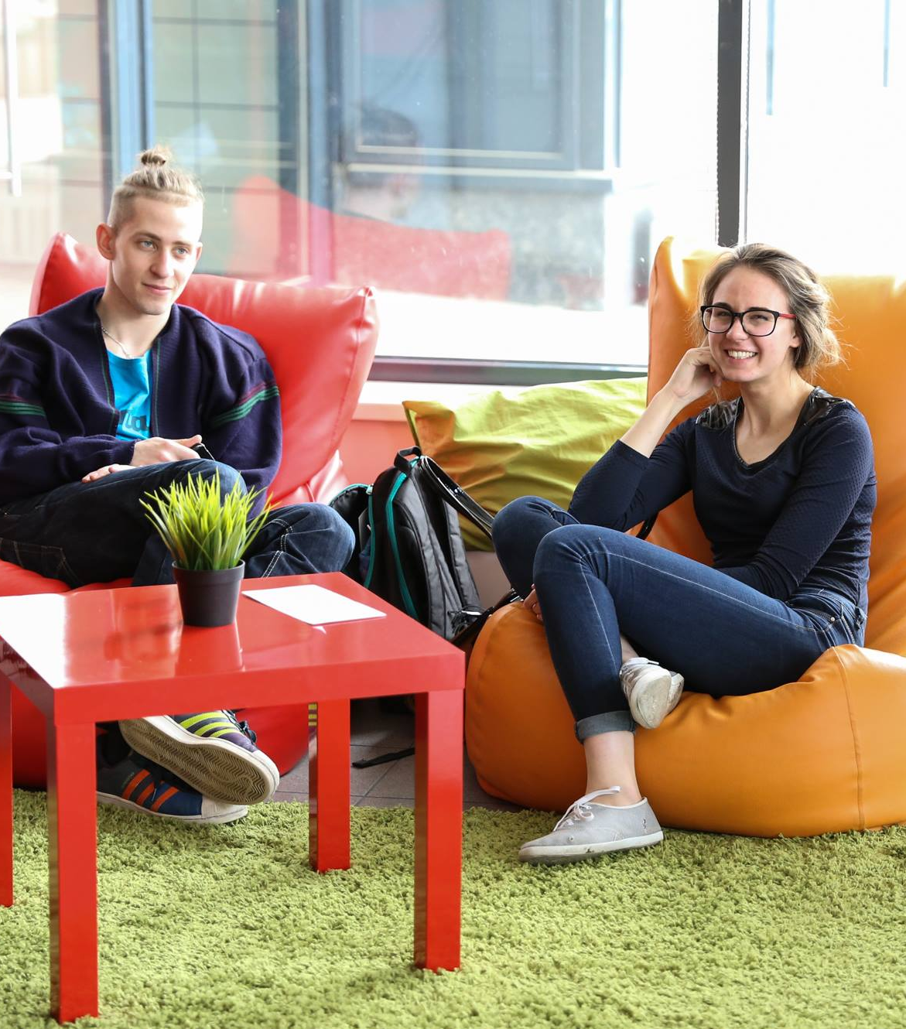
Accomodation
3 dormitory campuses in Vilnius
1 dormitory campus in Kaunas
Double or tripple rooms
Prices: 87 EUR for double room; 58 EUR for tripple room
High-speed internet (5 EUR/month)
Bedding, laundry facilities
Walking distance to University campuses, excellent connection to the city via public transport

Slide 18
Academic support
Orientation week:
Series of events, activities and lectures for new international students, designed to introduce students to Lithuanian culture; to provide students with practical living information and student life at Vilnius University.
Mentor programme:
All international students (exchange and full-time) receive a qualified mentor that helps integrate into the study process and adapt to the life at the University.
Academic consultants
All of the faculties have international academic consultants helping students choose courses, communicate with teachers, solve other issues related with the study process.
Other support
Psychological support for all students experiencing emotional and psychological difficulties is available at Vilnius University Psychological Training and Research Center. Report system for sexual harassment and discrimination cases is available for all the members of Vilnius University community. Dissability Affairs Coordinator at the University provides support in the adaptation of studies for students with special needs.

Slide 19

Career consultations
Seminars and workshops dedicated to successful job application and career planning
Individual career consultations
Job and internship offers from companies across Lithuania and Europe

Slide 20
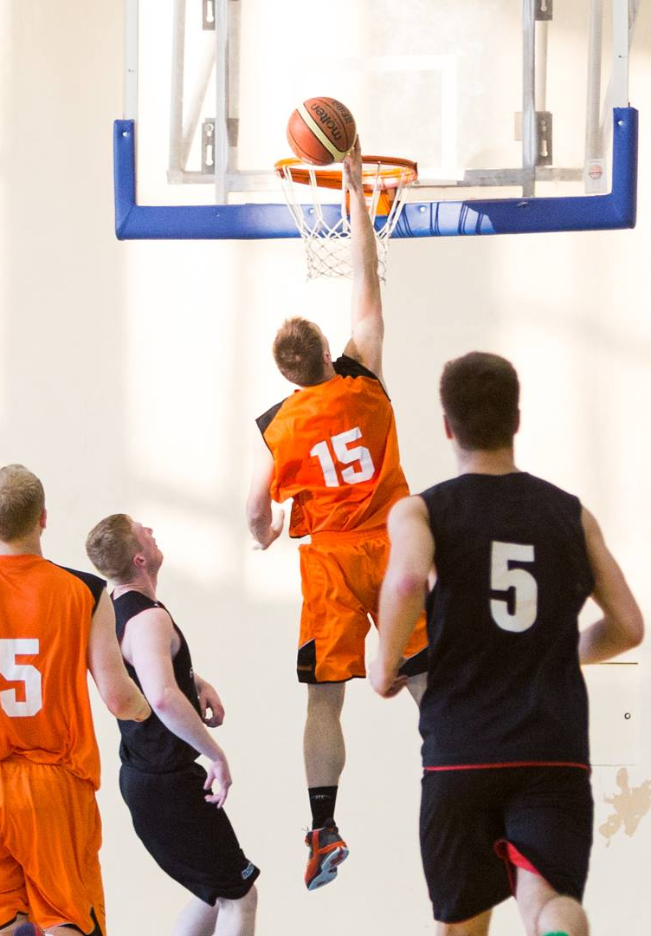
Sports and leisure
Vilnius University Health and Sport Centre:
Sports teams of the faculties (soccer, basketball, handball, volleyball, etc.)
Individual sports (gymnastics, athletics, swimming, etc.)
Official Vilnius University teams of professional sport that take part in national and international competitions.
Student clubs:
2 theatre troups, 3 song and dance ensembles, wind orchestra, 2 academic choirs, hikers club

Slide 21
Application procedure
Online application: apply.vu.lt
Application deadlines:
15 July for non EU/EEA applicants with Lithuanian Embassies residing in their home countries
1 June for applicants to Medicine and Dentistry programmes
Vilnius University is certified to perform independent process of recognition of qualifications in accordance with the policies of Centre for Quality Assessment in Higher Education of Lithuania.

Slide 22
CONTACTS
Muitines Street 8
LT-44280 Kaunas, Lithuania
+370 37 750914
admissions@knf.vu.lt

